Slide 1

Customer Retention Analysis
Submitted by :
Anchal Awasthi

Slide 2
Introduction
The customer retention definition in marketing is the process of engaging existing customers to continue buying products or services from your business. The best customer retention tactics enable you to form lasting relationships with consumers who will become loyal to your brand. They might even spread the word within their own circles of influence, which can turn them into brand ambassadors.
Successful e-commerce brands are often the ones that focus on their customer retention rate and keep working to improve it. Take the example of a newly launched online store that sells women’s shoes. They launch a social media campaign to get sign-ups from 20,000 women customers. The store then shoots emails and SMS to their list with exclusive discount offers for ‘VIP Members’.2,500 Women sign-up for the VIP membership to avail of exclusive discounts on the latest shoes. This new ‘VIP Members List’ now becomes valuable retained customers for the store.

Slide 3
Why perform customer retention analysis?
1. Improves ROI
2. Convert more sales
3. Spend less on TOFU marketing
4. Increase customer LTV
5. Earn more referrals

Slide 4
Why is Retention Important?
Loyal customers help increase sales
Buy higher priced options
Buy more often
Are less price sensitive
Are less costly to serve
Are more loyal
And have a higher lifetime value

Slide 5
How to retain them?
Recruit the right customers to begin with
Once you have them, segment them by lifetime value
Communicate with them to build loyalty

Slide 6
Problem Statement
Customer satisfaction has emerged as one of the most important factors that guarantee the success of online store; it has been posited as a key stimulant of purchase, repurchase intentions and customer loyalty. A comprehensive review of the literature, theories and models have been carried out to propose the models for customer activation and customer retention. Five major factors that contributed to the success of an e-commerce store have been identified as: service quality, system quality, information quality, trust and net benefit. The research furthermore investigated the factors that influence the online customers repeat purchase intention. The combination of both utilitarian value and hedonistic values are needed to affect the repeat purchase intention (loyalty) positively.

Slide 7
Data Analysis

Slide 8
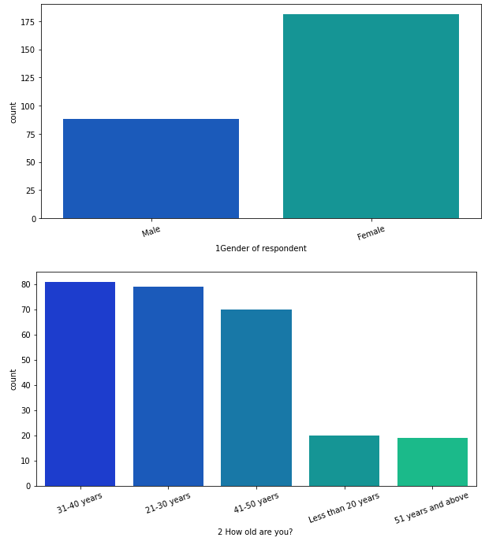
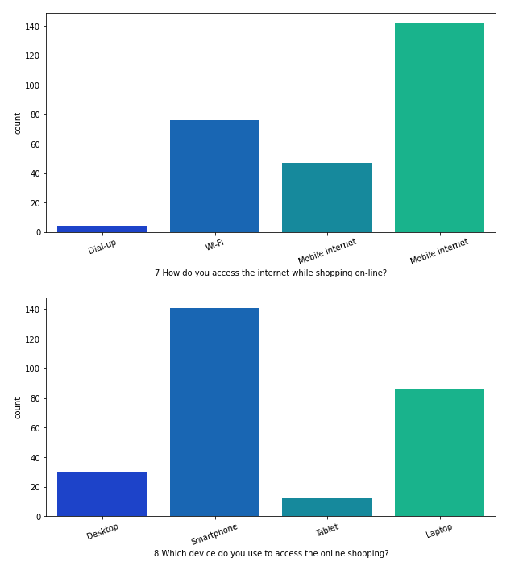

Slide 9
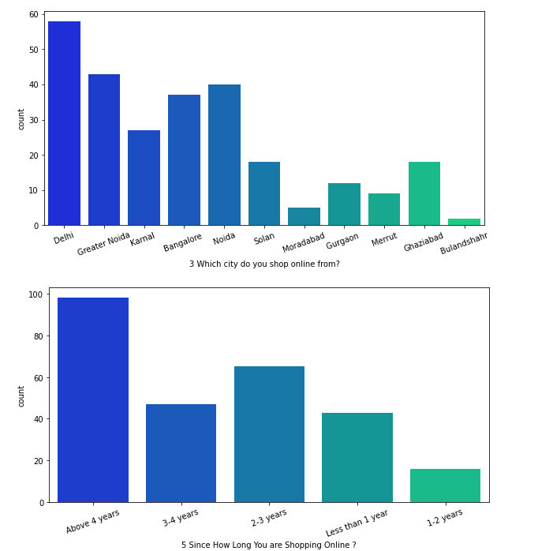
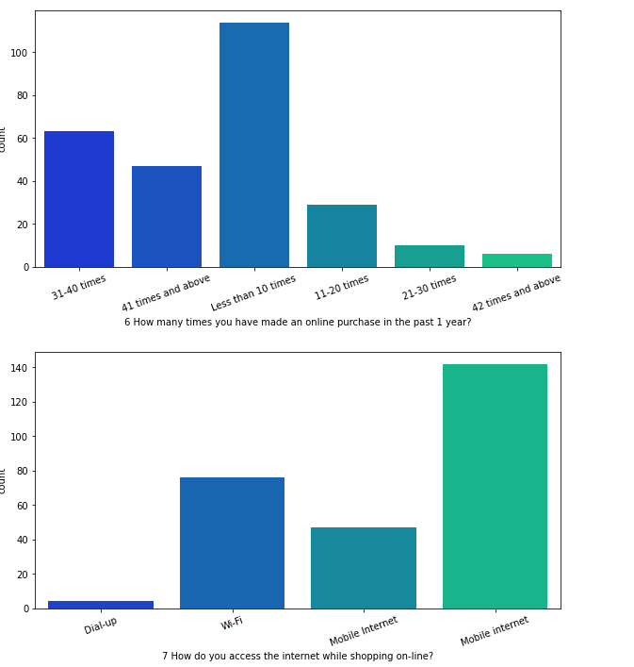

Slide 10
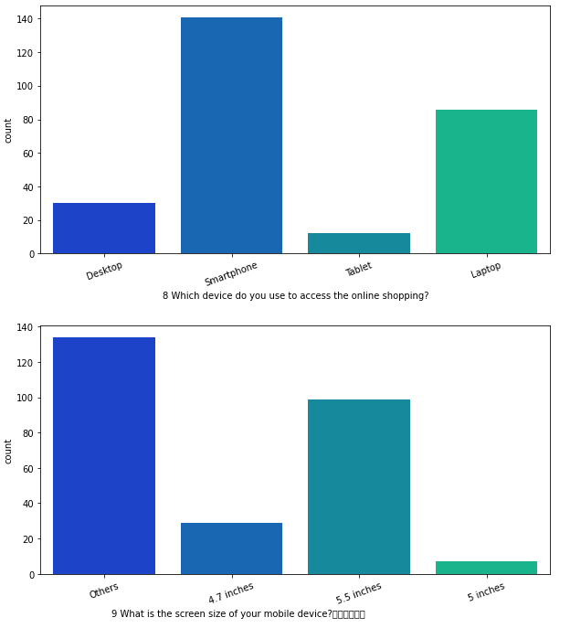
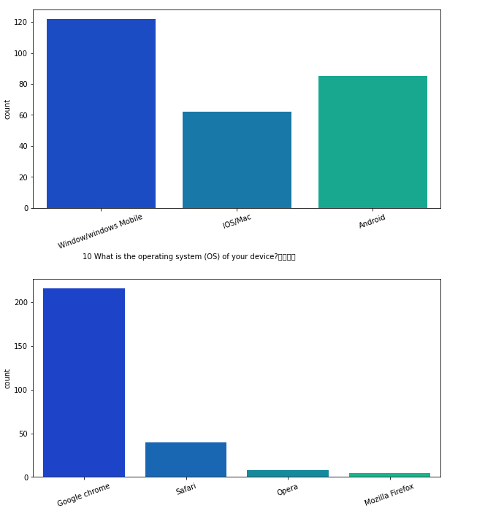

Slide 11
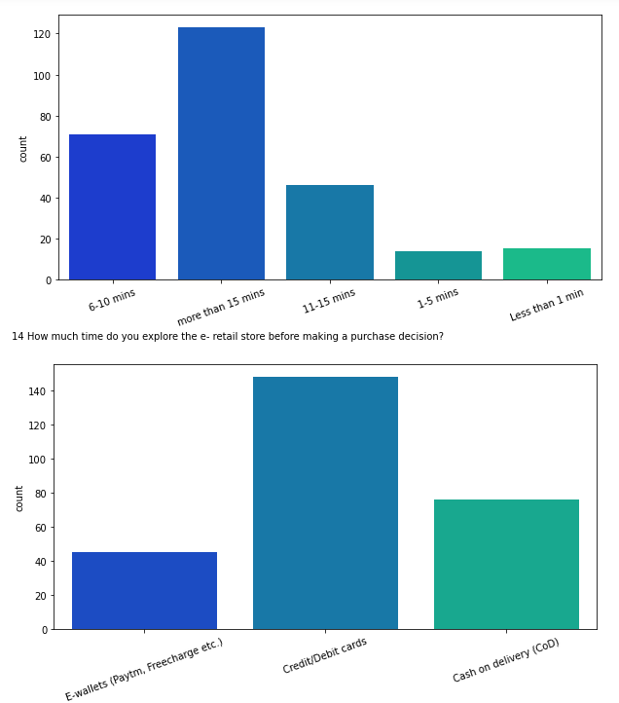
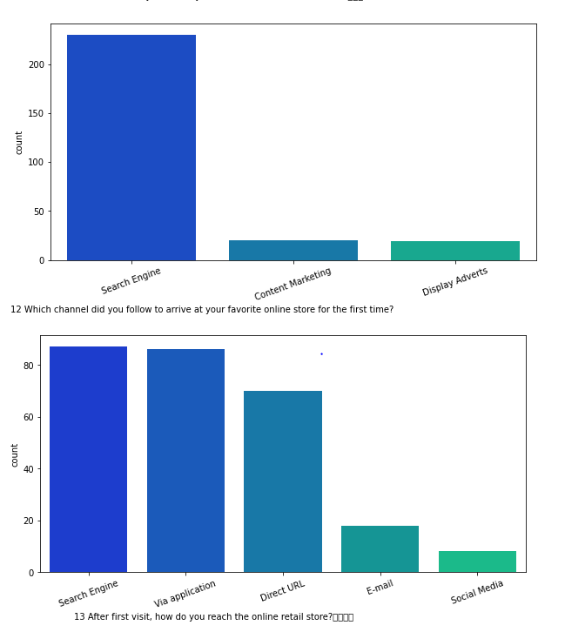

Slide 12
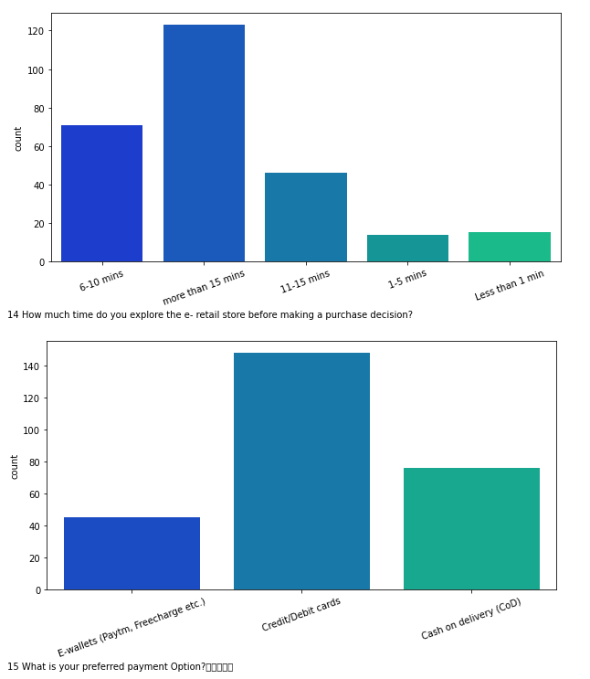
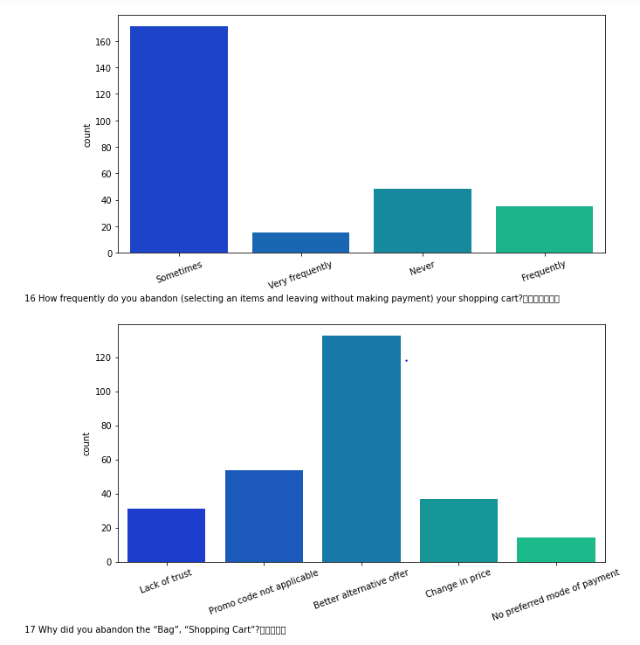

Slide 13
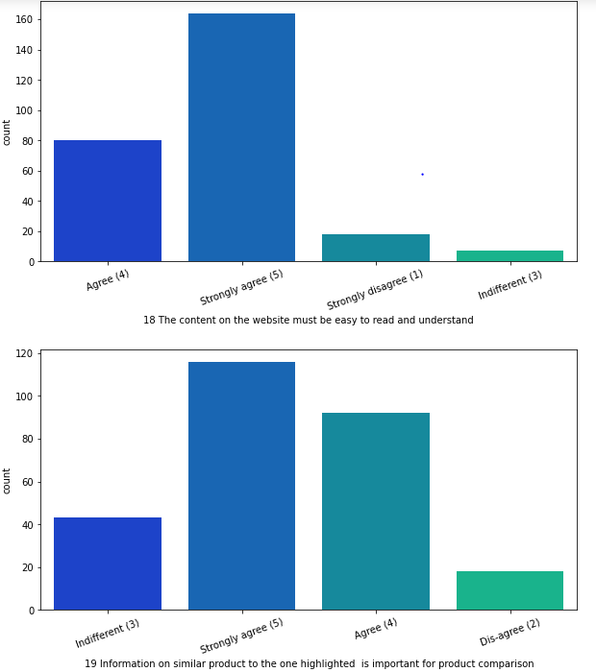
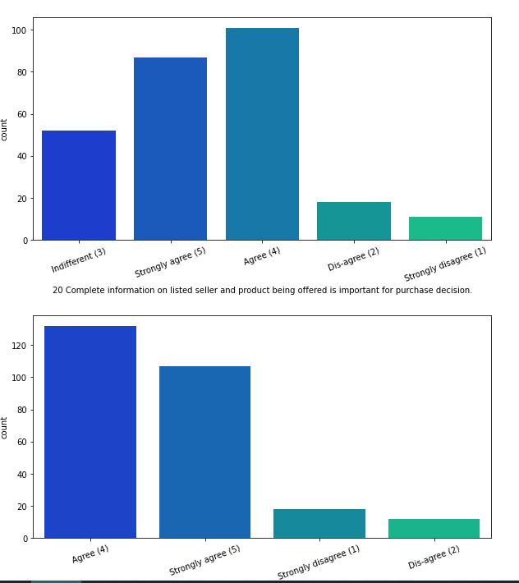

Slide 14
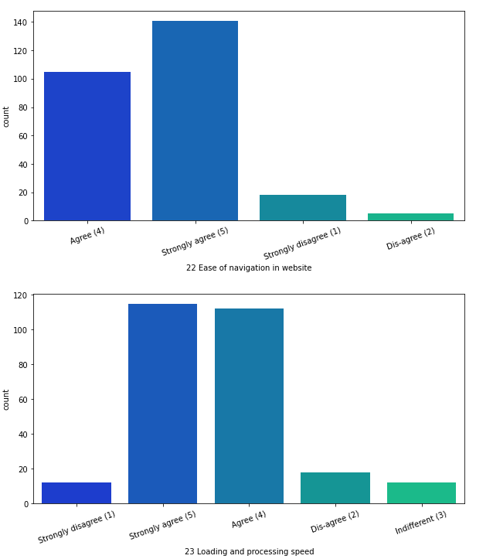
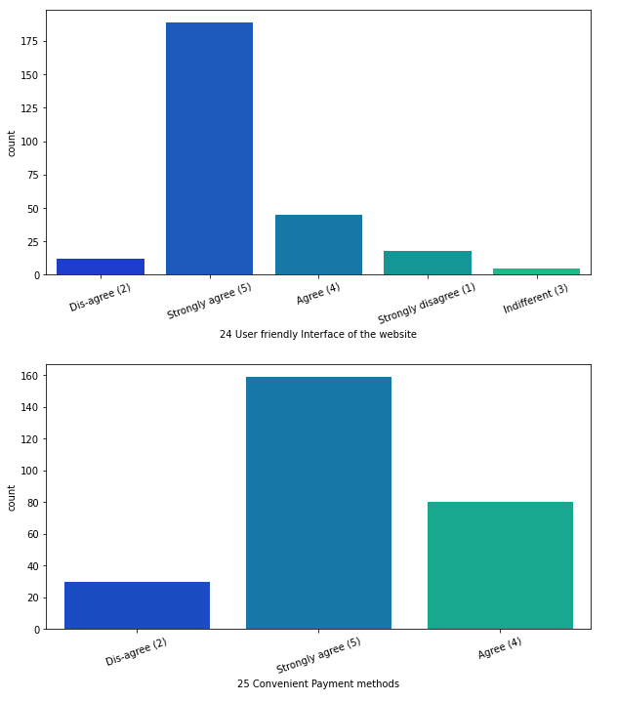

Slide 15
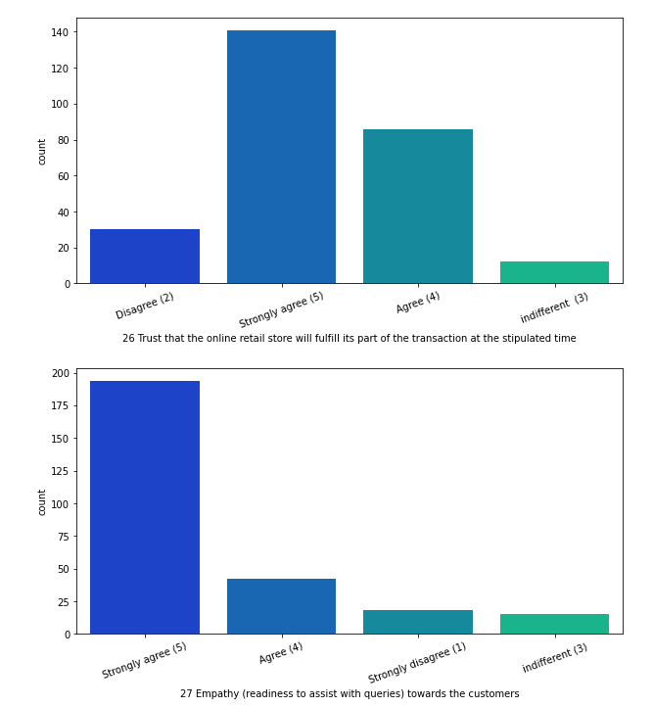
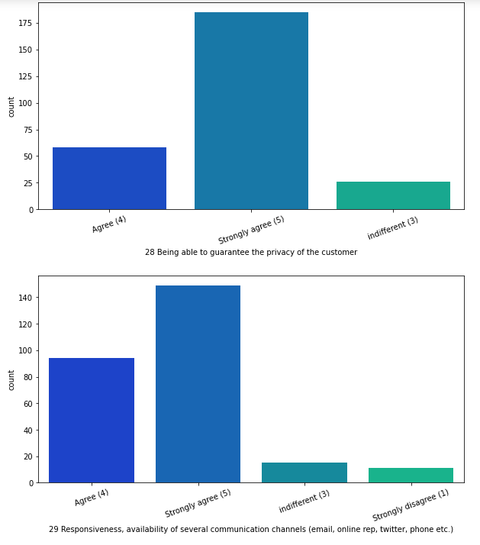

Slide 16
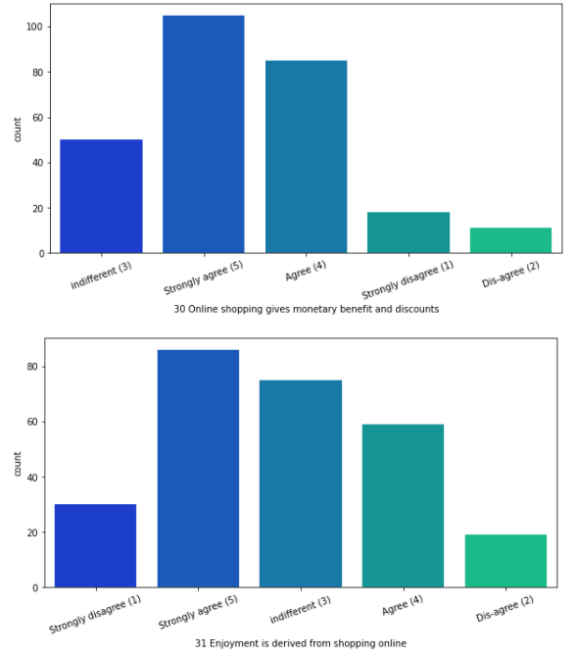
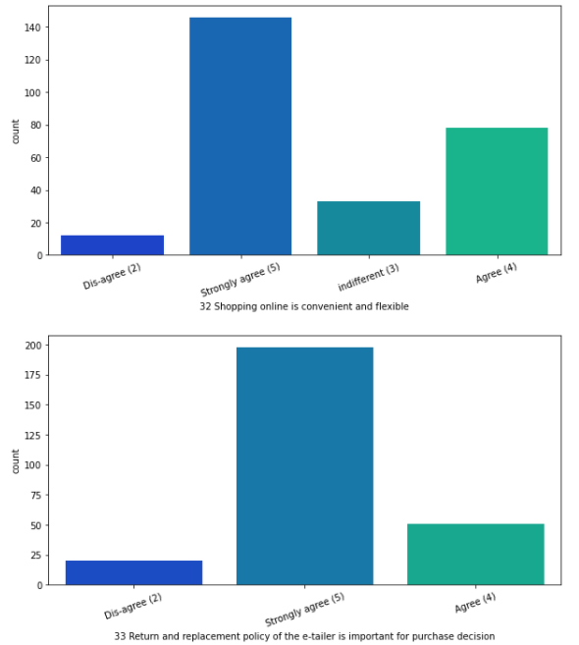

Slide 17
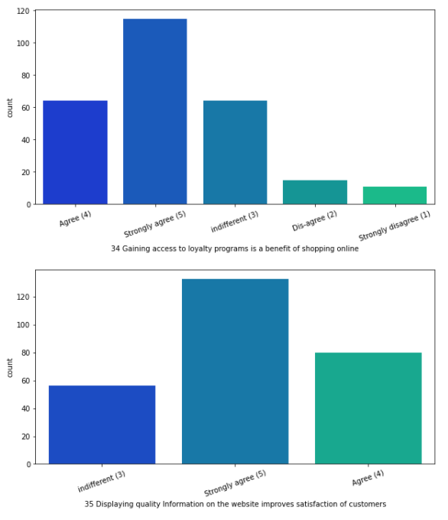
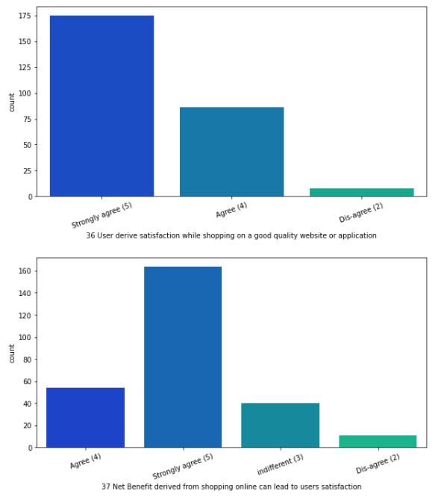

Slide 18
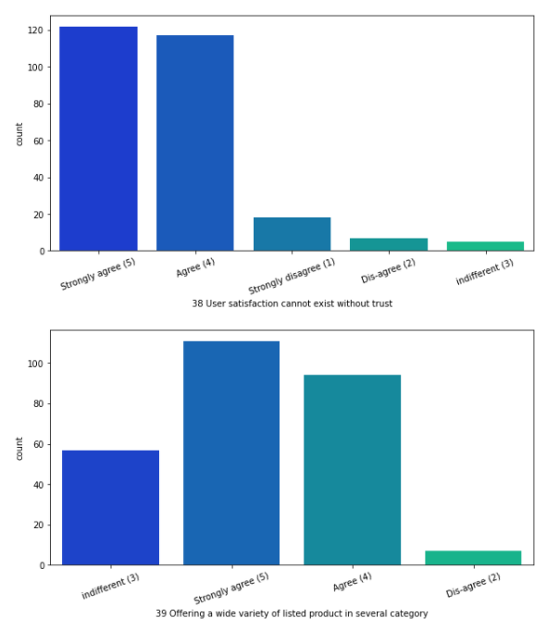
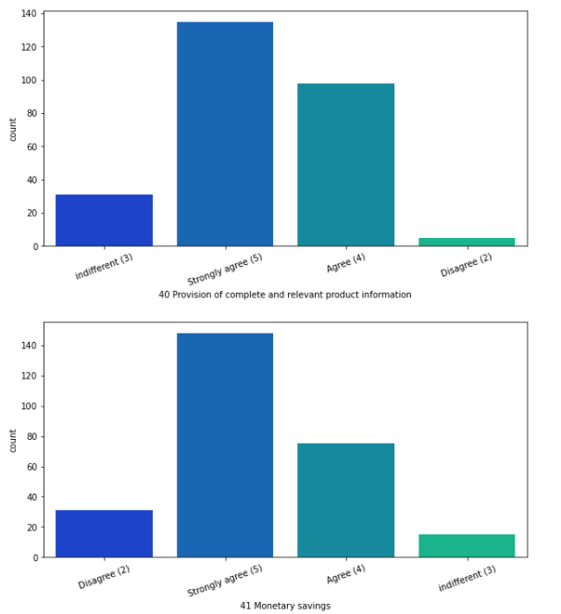

Slide 19
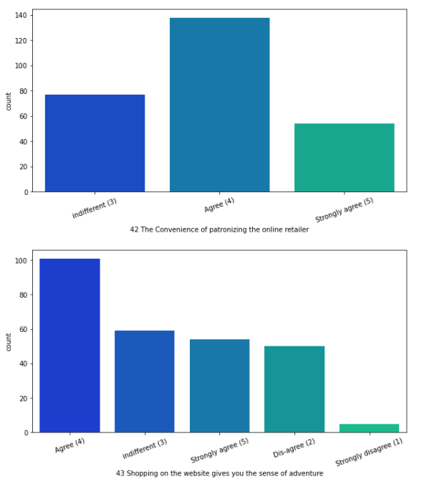
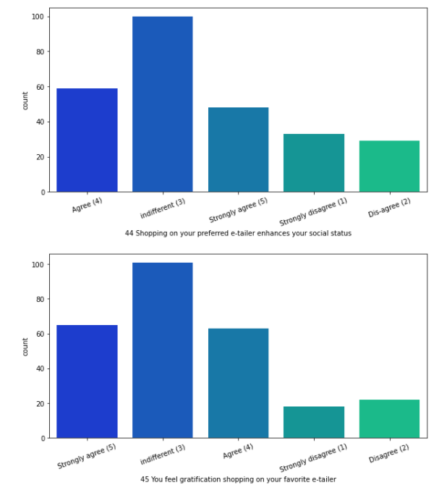

Slide 20
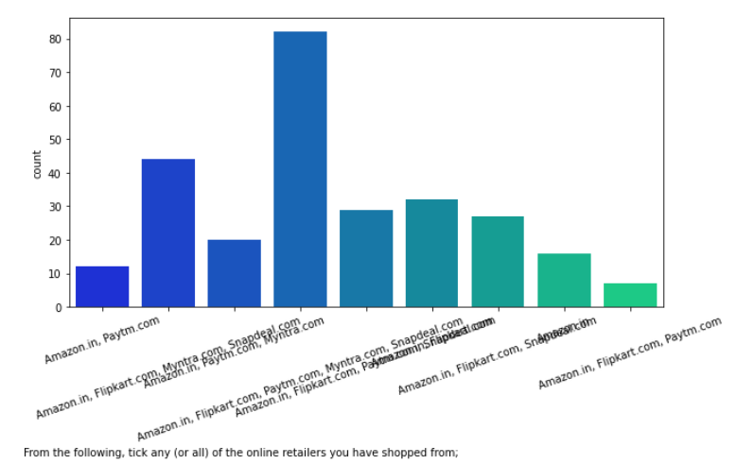
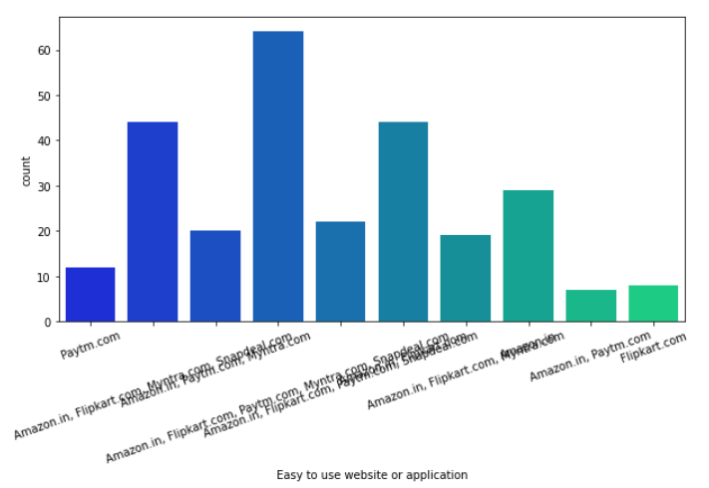

Slide 21
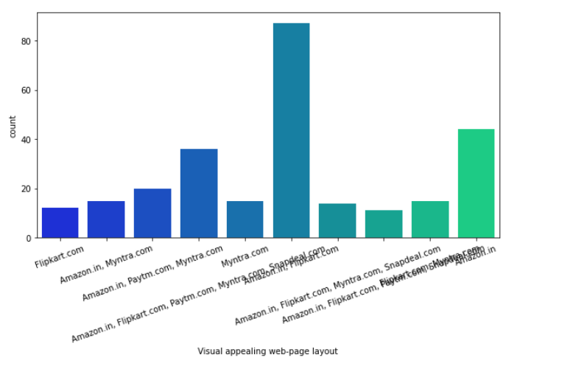
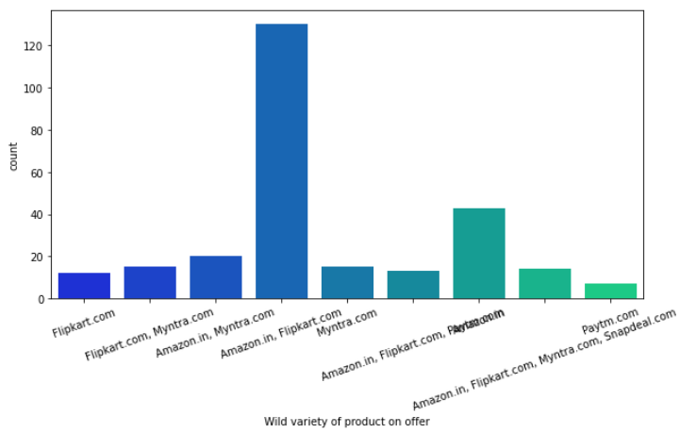

Slide 22
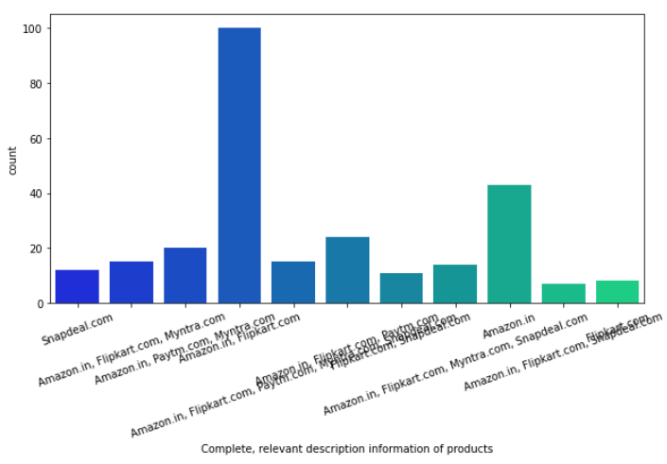
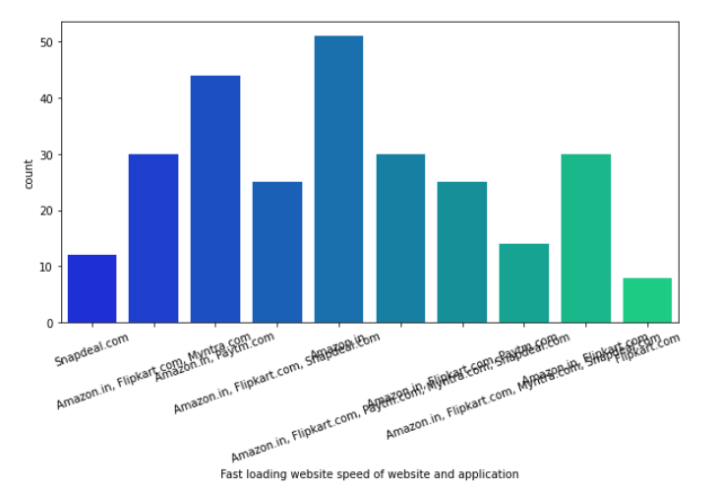

Slide 23
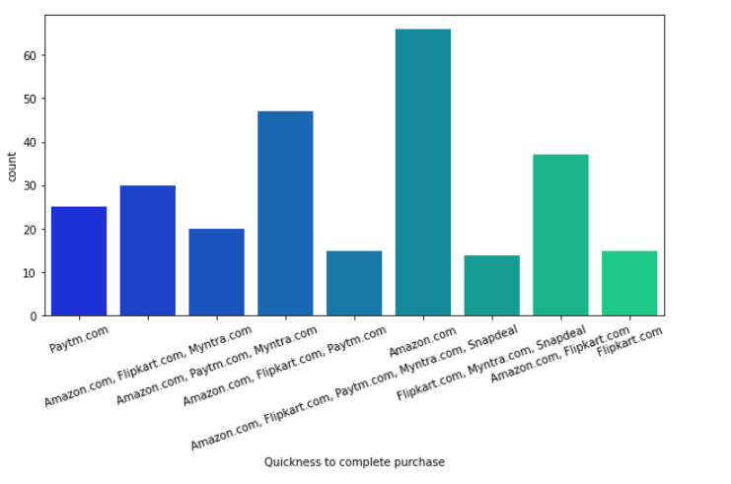
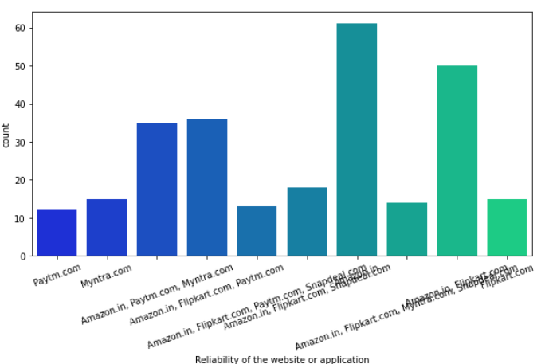

Slide 24
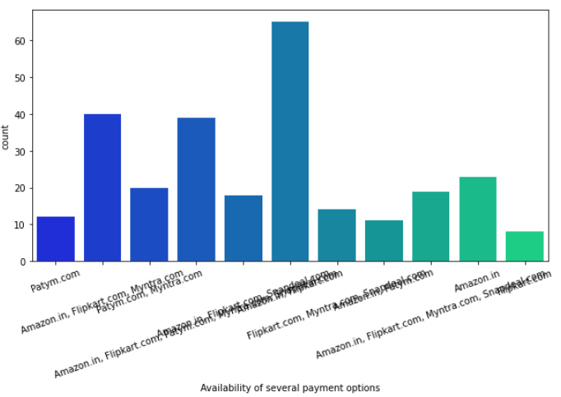
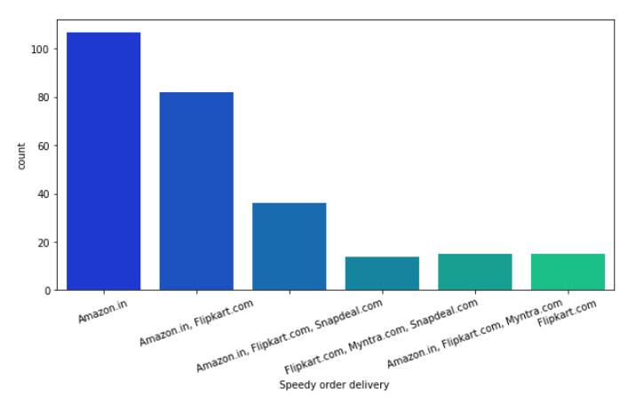

Slide 25
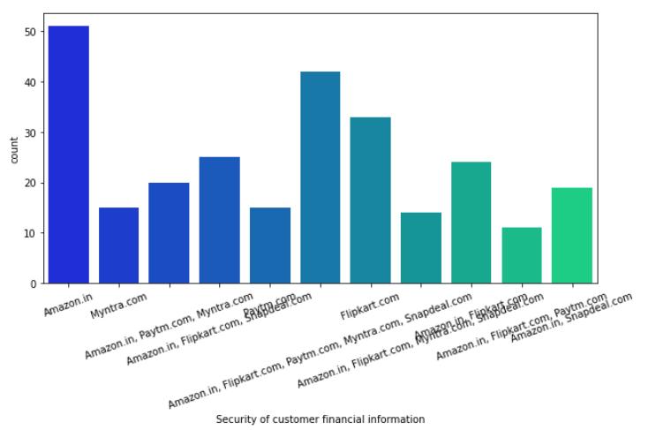
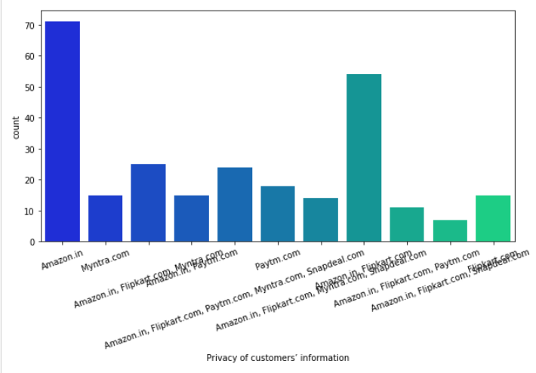

Slide 26
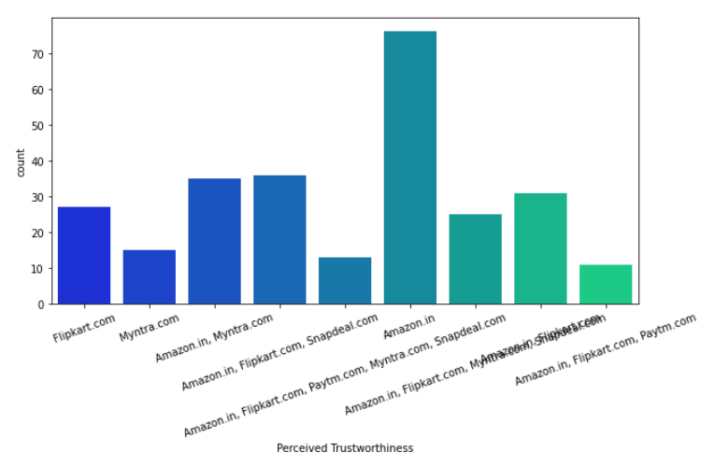
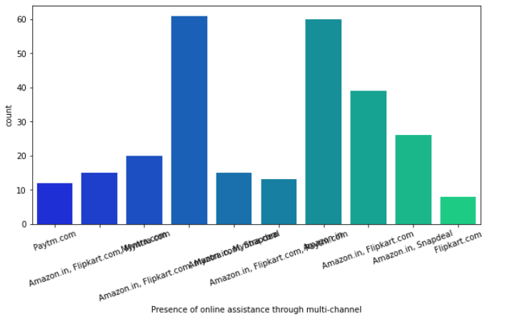

Slide 27
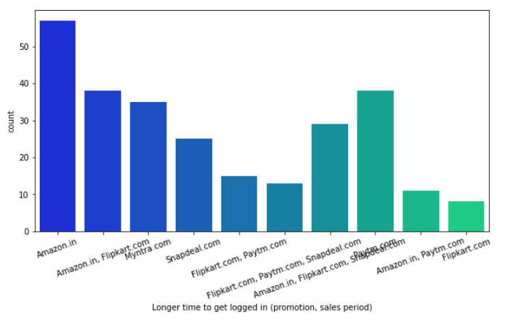
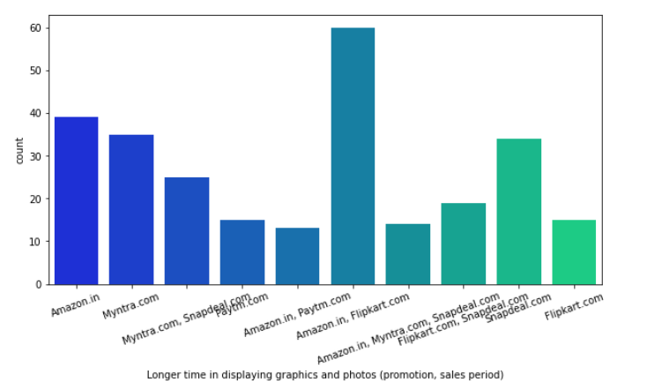

Slide 28
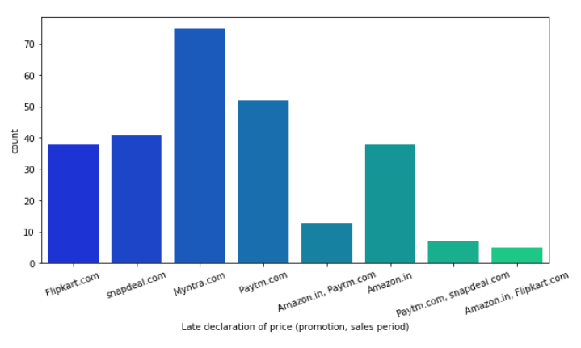
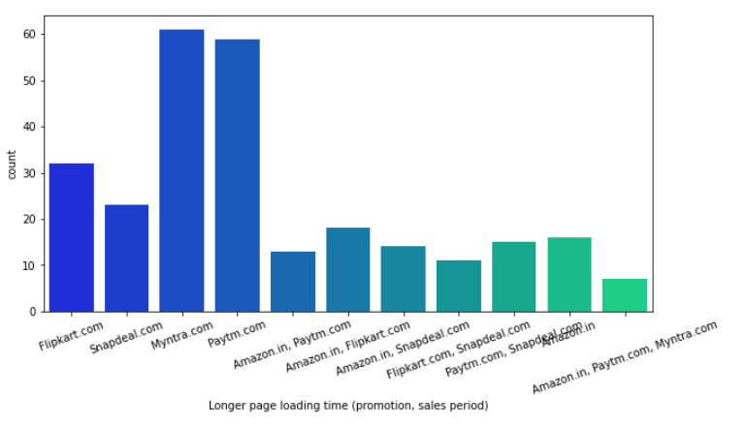

Slide 29
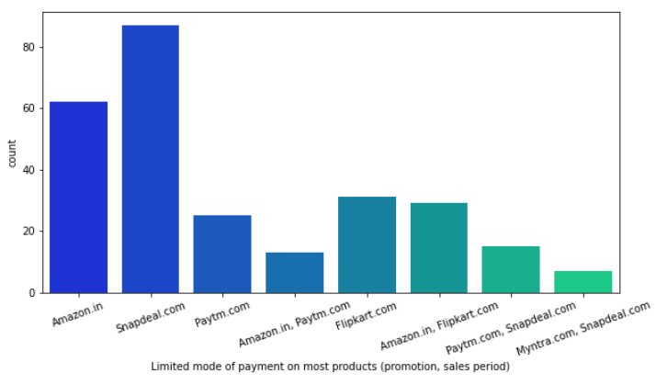
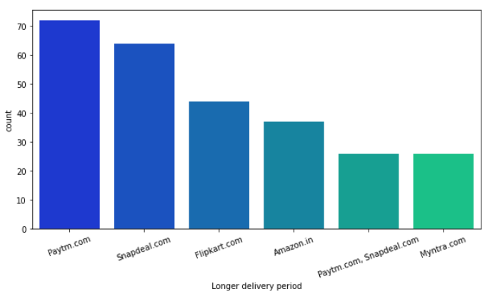

Slide 30
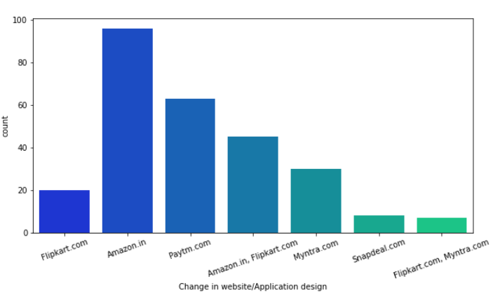
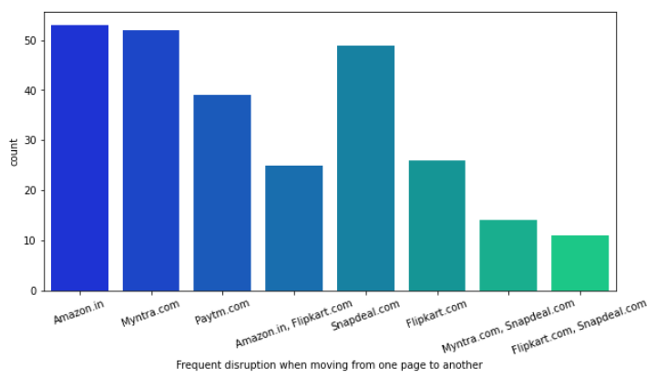

Slide 31
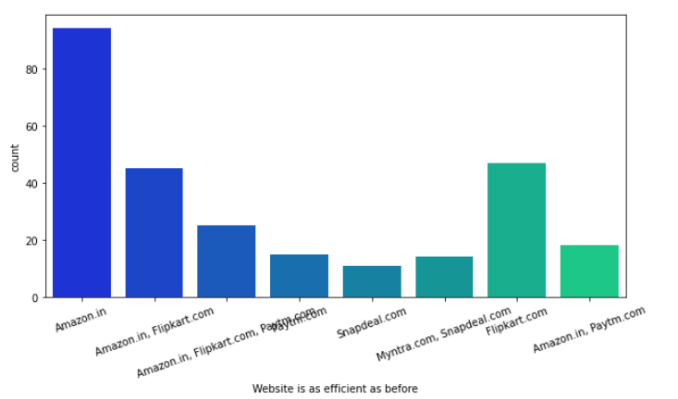
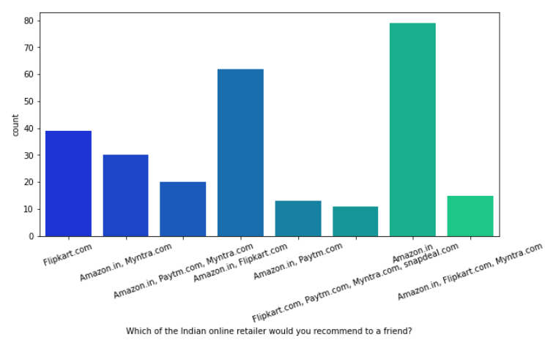

Slide 32
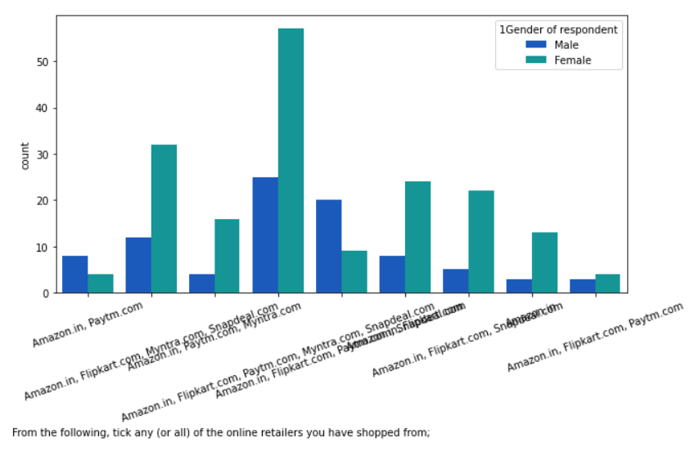
Most people strongly agree that Amazon.in, Paytm.com and Myntra.com are easy to use and maximum shopping has been done from these websites. Also it has complete and relevant information of products.

Slide 33
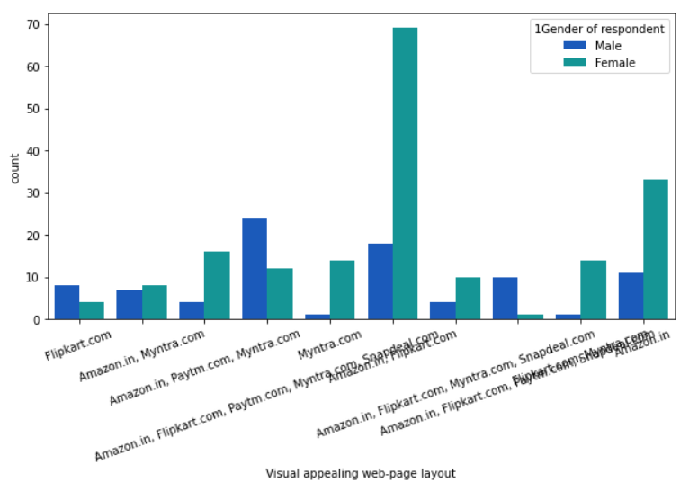
Most people strongly agree that Amazon.in, Flipkart.com, Paytm.com, Myntra.com and Snapdeal.com are visually appealing web page.

Slide 34

We will analyze our data for “How many times have you made an online purchase in the past 1 year” against other features and will analyze only for those customers who have made a purchase more than 20 times in an year.

Slide 35

Highest number of customers have shopped from Amazon.com, Paytm and Myntra. There is no customer who has not shopped from Amazon, making Amazon the market leader in this domain.

Slide 36

when it comes to the trustworthiness, Amazon again has earned a lot of brownie points and have outperformed the other companies. We can safely conclude that Amazon has outperformed the other portals in all the aspects of the survey and has clearly maintained its image. It has been able to retain its customers successfully as compared to the others in the market.

Slide 37
Conclusion
Females shop more than males, hence they're the target audience.
People in age group of 31-40 years shop maximum and least is done by 51 years.
People in metropolitan cities (Delhi, Greater Noida, Bangalore and Noida) exercise more online shopping.
Shoppers prefer Card payment option followed by COD.

Slide 38
Most of the shoppers strongly agree that
- content on the website must be easy to read and understand,
- Must have all the information on listed seller and product,
- There must be ease of navigation in website,
- Must have convenient payment method,
- must have empathy towards the customers
- online shopping gives monetary benefit and discounts
- There must be return and replacement policy of the e-tailer for purchasing

Slide 39
Shoppers agree that they are getting value for money spent
They also strongly agree that Amazon.in, Paytm.com and Myntra.com are easy to use and maximum shopping has been done from these websites, also they have complete and relevant information of products
Amazon and Flipkart offer wide variety of products Amazon has fastest delivery followed by Flipkart and Myntra. Also they are highly satisfactory in terms of privacy of customer information.
Moreover Amazon website is best since its extremely efficient. Snapdeal provides limited mode of payment and has frequent disruption on moving from one page to other. Most of the people would refer Amazon to others.
Females in age group 21-30 years do maximum shopping.

Slide 40
Females from greater Noida and males from Delhi do maximum shopping
Most of the females shop from Amazon, Flipkart, Paytm, Myntra, Snapdeal as they find it easy to use and find amazon reliable
Males find amazon, Flipkart and Paytm to be equally reliable.
Both male and female agree that amazon is as efficient as before.
Moreover they both would recommend amazon to a friend.
Shopping on your preferred e-tailer enhances your social status: This attribute has only 17% of the customers who strongly agree. This is because most of the customers will go to the shopping malls for the social status as ordering online doesn't usually help in showing off.

Slide 41
The Convenience of patronizing the online retailer : This attribute has only 20% of the customers who strongly agree. This means that the customers are not much concerned about patronizing with the retailer.
Return and replacement policy of the e-tailor is important for purchase decision: It has whopping 73% of the customers who strongly agree to it. It is evident from the fact that people cannot actually try, touch and feel the products that they are purchasing before they reach home and they would want to return or replace in case of dissatisfaction. Online shopping websites should make strategies around easy return and replacement policy if they want to retain their customers. It also reveals that touch and feel is an important aspect of shopping.
Empathy (readiness to assist with queries) towards the customers: This also has a high percentage of 72. The reason is insecurity amongst the customers. If they have a provision of a helpline number associated with the website, that sense of insecurity vanishes and the customer can trust the website more. A 24X7 support is a must for these online retail stores.

Slide 42
User friendly Interface of the website: Just like the navigation in a physical store should be easy, same is the case with the online retail store so that the customers do not have to work around much and the overall shopping experience is smooth. The retail stores should invest heavily in creating user friendly apps and websites.
Being able to guarantee the privacy of the customer: This also got 68% strongly agree. Everyone is concerned of their privacy. If there is a website that posts about your recent purchase on its social media and tags you without your consent can be a breach of privacy. Imagine buying underwear's and being tagged by amazon on Facebook for doing so.
Convenient Payment methods: This also had 59% people strongly agreeing. Cash on delivery, online cards and upi, all the methods should be available for the customers to make the transaction.
Responsiveness, availability of several communication channels (email, online rep, twitter, phone etc.): In case one channel is not available, customers can reach out to multiple channels which again is an important factor. We have recently seen customers reaching out to Amazon and Flipkart's Twitter handles and raising issues over there which are readily resolved.

Slide 43
Thank You

